Slide 1
19-6-25

Slide 2
Sim:
0.5x0.5 um, 10x10 pixels
50 repetitions for each combination of (laser intensity, emitter density)

Slide 3
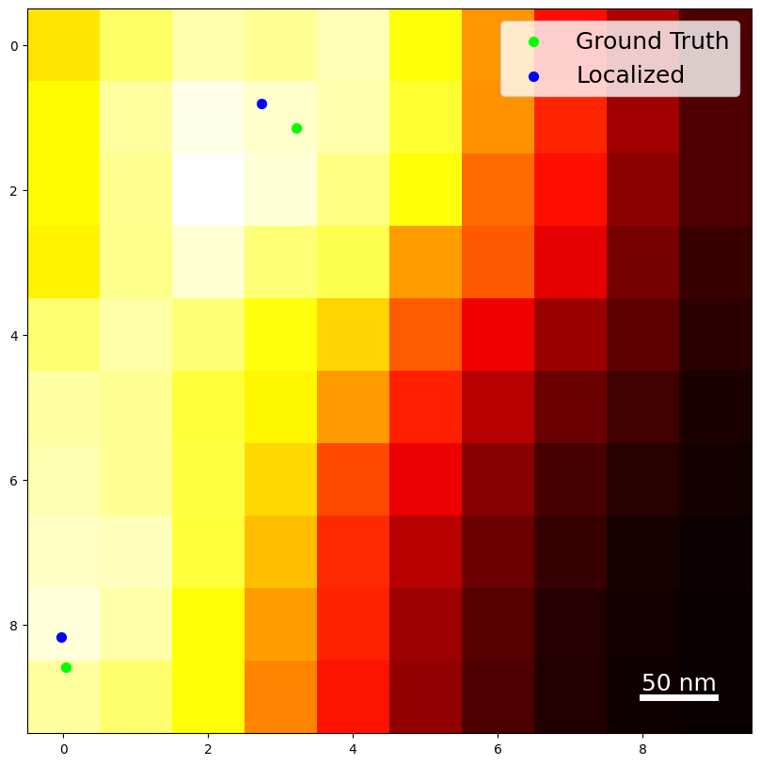
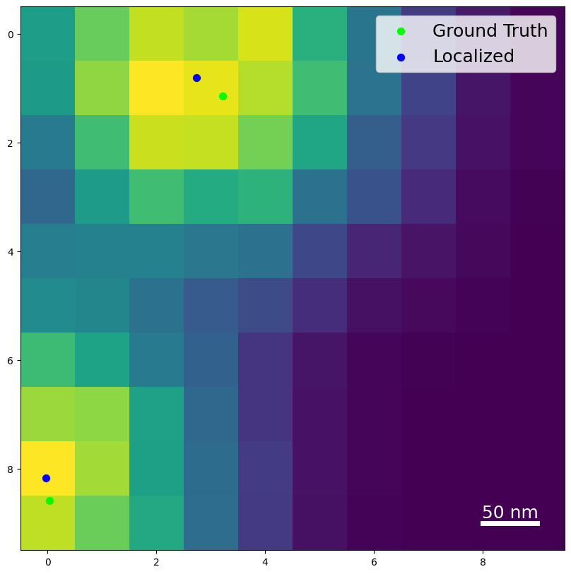
Example image 300kW power, 10 emitters/um^2
Intensity image G2 image

Slide 4
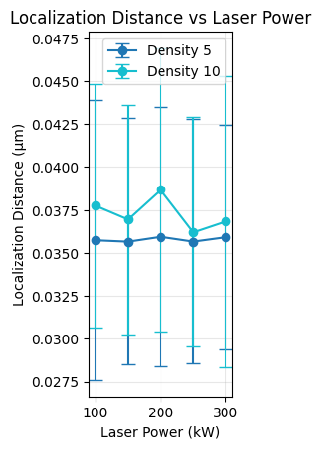
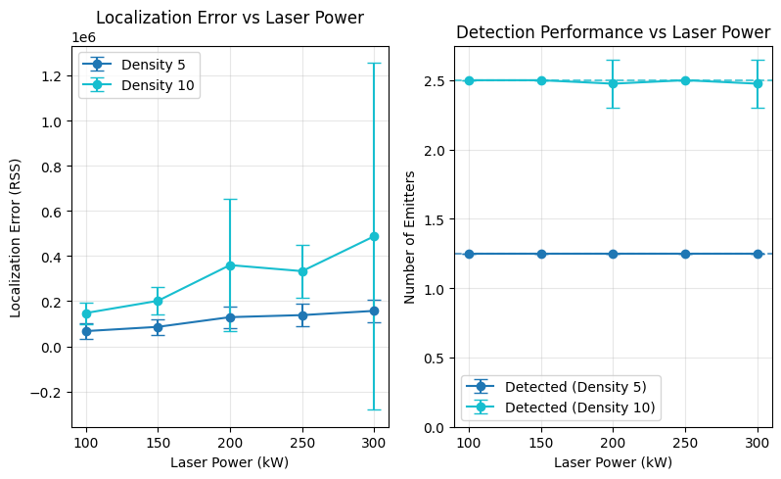

Slide 5
Larger run
Emitter densities 5, 10, 20 emitters per square micrometer
50-300 kW laser power
25 simulations per combination

Slide 6
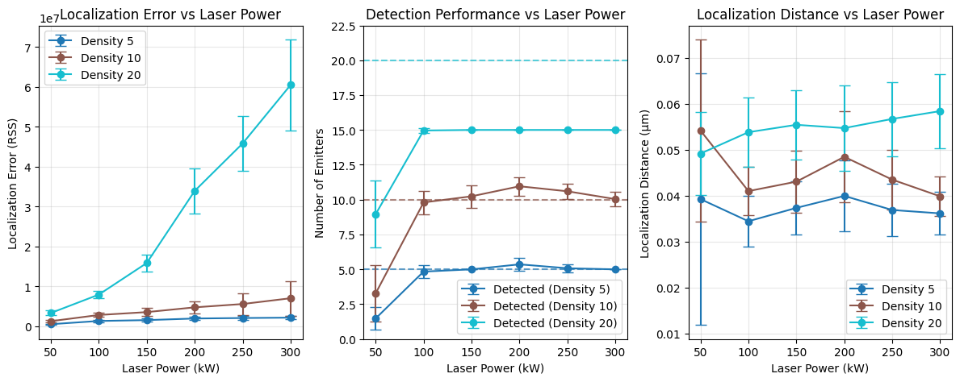
Notes:
Localization error: the residuals of the final localization setup (average)
Detection performance: shows the average number of detected emitters vs the ground truth number of emitters.
Localization distance: the average distance to the ground truth locations

Slide 7
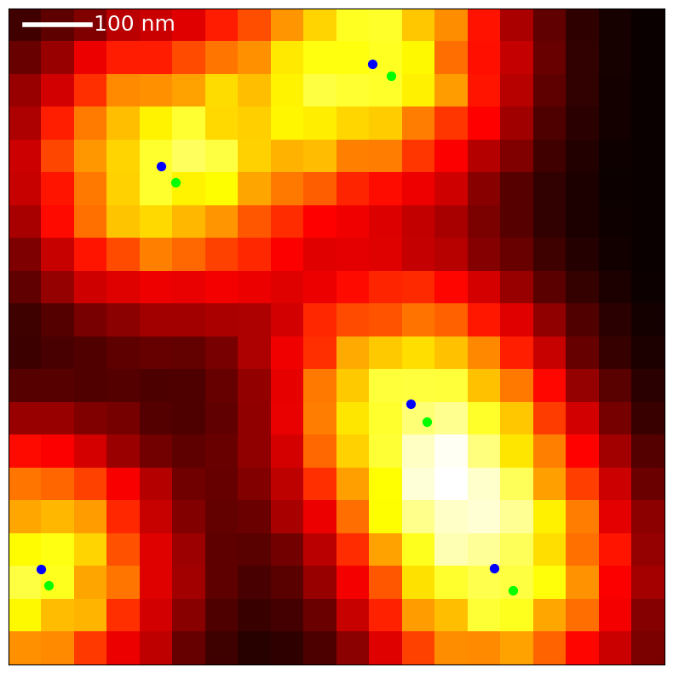
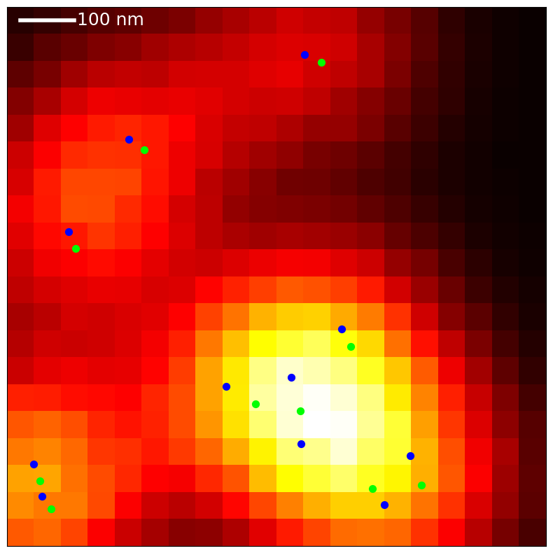
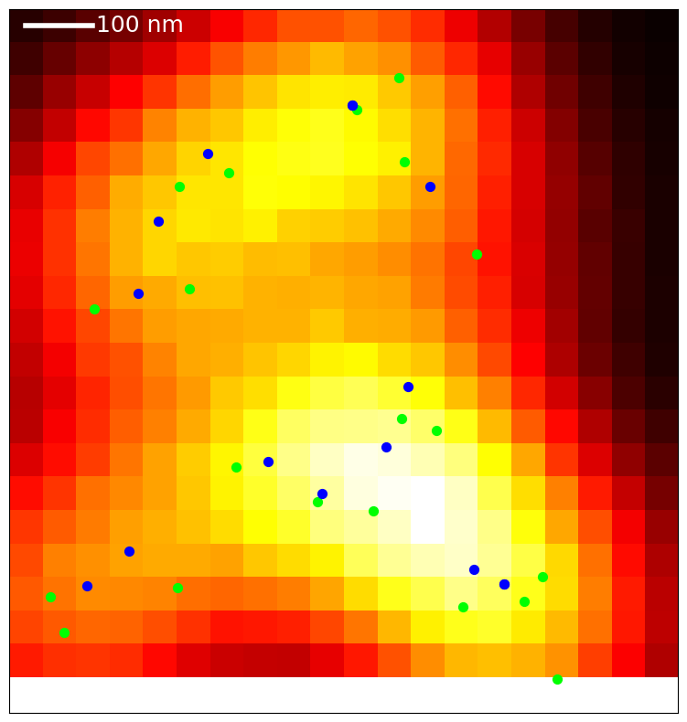
5 emitters 10 emitters 20 emitters
For 20 emitters, the localization distance (distance to nearest ground truth emitter) is large overestimation of accuracy.

